Slide 1


Graphics
Images within 2D games
Part 7 – Tiling

Slide 2

Images Tiles

Slide 3
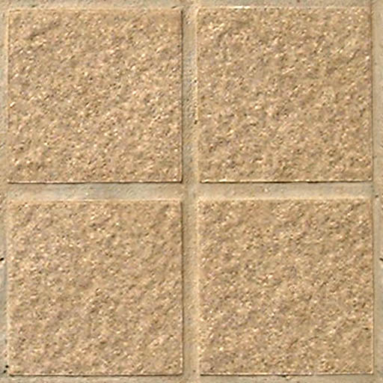
An image tile is simply an image that is intended to be repeatedly drawn next to itself in a tiled pattern.
Tiled images can often be found within games as a means of providing a memory efficient means of generating background surfaces, etc.

Slide 4

Develop an algorithm to fill up the viewport with image tiles, given:
An image tile, with width t_{w} and height t_{h}
A viewport starting from v_{x},v_{y} (somewhere within the tile) and with width v_{w} and height v_{h}
v_{w}
t_{w}
v_{h}
t_{h}
v_{x},v_{y}
Start
x=0, y=0
10 mins
9 mins
8 mins
7 mins
6 mins
5 mins
4 mins
3 mins
2 mins
1 min
30 sec
Finished

Slide 5
Start drawing from v_{x},v_{y} and draw as much of image tile as possible
Move along the y-axis to where is the topmost bound of drawn tile
Draw another tile here (with the same x value as the original tile).
Keep doing steps 2 and 3 until we’ve painted the entire ‘column’
Move along the x-axis to the rightmost bound of the last drawn tile
Repeat step 2,3,4 and 5 for this ‘column’
Keep moving along the x-axis until whole viewport is painted

Slide 6
int drawXOffset = 0, drawYOffset = 0;
int tileXOffset = viewPortX, tileYOffset = viewPortY
int drawWidth = 0, drawHeight = 0;
width
drawXOffset, drawYOffset – relative to the viewport
height
tileXOffset, tileYOffset – relative to the tile
tileHeight
viewPortX, viewPortY
tileWidth

Slide 7
int drawXOffset = 0, drawYOffset = 0;
int tileXOffset = viewPortX, tileYOffset = viewPortY
int drawWidth = 0, drawHeight = 0;
while( drawXOffset < width )
{
drawYOffset = 0; tileYOffset = viewPortY;
while( drawYOffset < height )
{
width
drawXOffset, drawYOffset
height
tileHeight
viewPortX, viewPortY
tileWidth

Slide 8
int drawXOffset = 0, drawYOffset = 0;
int tileXOffset = viewPortX, tileYOffset = viewPortY
int drawWidth = 0, drawHeight = 0;
while( drawXOffset < width )
{
drawYOffset = 0; tileYOffset = viewPortY;
while( drawYOffset < height )
{
drawWidth = tileWidth - tileXOffset;
if( drawWidth > width - drawXOffset ) drawWidth = width - drawXOffset;
drawXOffset tileXOffset
drawXOffset tileXOffset
drawXOffset tileXOffset
tileWidth
tileWidth
tileWidth
Full tile width
Tile starts outside
Tile ends outside

Slide 9
int drawXOffset = 0, drawYOffset = 0;
int tileXOffset = viewPortX, tileYOffset = viewPortY
int drawWidth = 0, drawHeight = 0;
while( drawXOffset < width )
{
drawYOffset = 0; tileYOffset = viewPortY;
while( drawYOffset < height )
{
drawWidth = tileWidth - tileXOffset;
if( drawWidth > width - drawXOffset ) drawWidth = width - drawXOffset;
drawHeight = tileHeight - tileYOffset;
if( drawHeight > height - drawYOffset) drawHeight = height - drawYOffset;
// Draw to(drawXOffset, drawYOffset)
// from (tileXOffset, tileYOffset) source
//region of size drawWidth x drawHeight
drawHeight
tileXOffset, tileYOffset
drawXOffset, drawYOffset
drawWidth

Slide 10
while( drawXOffset < width )
{
drawYOffset = 0; tileYOffset = viewPortY;
while( drawYOffset < height )
{
// Determine draw regions
// Draw tile
drawYOffset += drawHeight
tileYOffset = (tileYOffset+drawHeight) % tileHeight;
}
drawXOffset += drawWidth;
tileXOffset = (tileXOffset+drawWidth) % tileWidth;
}
drawHeight
drawXOffset
drawYOffset
tileXOffset
tileYOffset
drawWidth

Slide 11

Key takeaways:
Images can be tiled to cover a region of the screen. They provide a useful means of tiling an image to provide a seamless background.

